Slide 1

DISCLAIMER
The information in this presentation is provided to you by PT. AXAR Technology Raya, solely for informational purposes and does not constitute an offer to buy, sell or issue, or a solicitation of an offer to sell, buy or acquire any securities of the Company in any jurisdiction or an inducement to enter into investment activity, nor may it or any part of it form the basis of or be relied on in connection with any contract or commitment whatsoever. No representations or warranties, express or implied, are made by the Company, any underwriters, any of their respective affiliates, directors, officers, employees, advisors or representatives with respect to, and no reliance should be placed, on the accuracy, fairness or completeness of the information presented or contained in this presentation. By viewing this presentation, you agree that none of the Company, any underwriters, nor any of their respective affiliates, directors, officers, employees, advisors or representatives accepts any responsibility or liability whatsoever for any loss howsoever arising from any information presented or contained in or derived from or omitted from this presentation. The information presented or contained in this presentation was obtained from various sources, including certain third parties, and has not been independently verified, and its accuracy is not guaranteed.
This presentation does not contain all relevant information relating to the Company or its securities, particularly with respect to the risks and special considerations involved with an investment in the securities of the Company. These materials are not an offer of securities for sale. Any public offering will be made by means of a prospectus that may be obtained from the issuer and that will contain detailed information about the company and management, as well as financial statements. This presentation speaks as of its date and the information presented or contained in this presentation is subject to change without notice or update.
This presentation contains statements that constitute forward-looking statements. These statements include descriptions regarding the intent, belief or current expectations of the Company or its officers about the future. These statements can be recognized by the use of words such as “expects,” “plans,” “will,” “estimates,” “projects,” “intends,” or words of similar meaning. Such forward-looking statements are not guarantees of future performance and involve risks and uncertainties, and actual results may differ from those in the forward-looking statements as a result of various factors and assumptions, many of which are beyond the Company’s control. The Company or any of its affiliates, advisors, representatives or underwriters has no obligation and does not undertake to revise forward-looking statements to reflect future events or circumstances.
THE INFORMATION CONTAINED IN THIS DOCUMENT IS HIGHLY CONFIDENTIAL AND MAY NOT BE FORWARDED, PUBLISHED OR DISTRIBUTED, DIRECTLY OR INDIRECTLY, TO ANY OTHER PERSON (WHETHER WITHIN OR OUTSIDE YOUR ORGANIZATION/FIRM) FOR ANY PURPOSE AND MAY NOT BE REPRODUCED IN ANY MANNER WHATSOEVER. ANY FORWARDING, PUBLICATION, DISTRIBUTION OR REPRODUCTION OF THIS DOCUMENT IN WHOLE OR IN PART IS UNAUTHORIZED.
MOBILE
DEVELOPMENT
DAY 1

Slide 2
OBJECTIVES
Read Data Firestore
Dokumen & Query Snapshot
Macam-macam query
Add, Update, Delete
Notes:
Save Time....:
The Platform will house/aggregate thousands of DIRECT SUPPLIERS. Buyer members are now abled to easily Pick whats best suitable for them.
Discover...:
Suppliers need to be a registered and verified members. There will be features such as ratings and certifications to boost further.
Grow Business:
Members akan di-empowered dengan sebuah tool digital yang yang tadinya menyerang industri, malah justru membuat mereka bisa menjadi lebih kompetitif di era digital.

Slide 3
Read Data Firestore
Membaca menggunakan firestore dapat dibagi menjadi 2, yaitu : onetime read dan realtime read.
Onetime Read
Untuk membaca koleksi atau dokumen sekali, panggil metode Query.get atau DocumentReference.get. Dalam contoh di bawah ini, FutureBuilder digunakan untuk membantu mengelola status request:
Notes:
Save Time....:
The Platform will house/aggregate thousands of DIRECT SUPPLIERS. Buyer members are now abled to easily Pick whats best suitable for them.
Discover...:
Suppliers need to be a registered and verified members. There will be features such as ratings and certifications to boost further.
Grow Business:
Members akan di-empowered dengan sebuah tool digital yang yang tadinya menyerang industri, malah justru membuat mereka bisa menjadi lebih kompetitif di era digital.

Slide 4
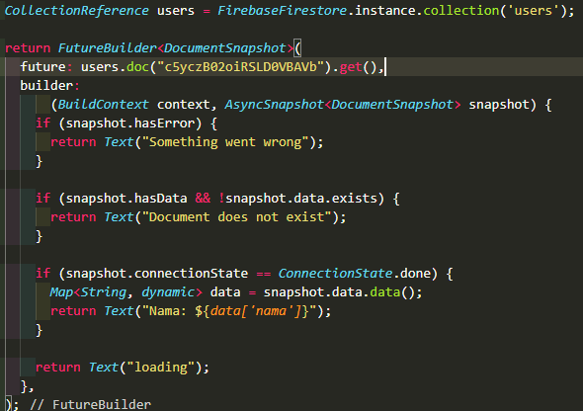
Read Data Firestore
Notes:
Save Time....:
The Platform will house/aggregate thousands of DIRECT SUPPLIERS. Buyer members are now abled to easily Pick whats best suitable for them.
Discover...:
Suppliers need to be a registered and verified members. There will be features such as ratings and certifications to boost further.
Grow Business:
Members akan di-empowered dengan sebuah tool digital yang yang tadinya menyerang industri, malah justru membuat mereka bisa menjadi lebih kompetitif di era digital.

Slide 5
Read Data Firestore
Realtime Read
FlutterFire menyediakan dukungan untuk menangani perubahan waktu nyata pada koleksi dan dokumen. Peristiwa baru disediakan atas permintaan awal, dan setiap perubahan berikutnya pada koleksi / dokumen setiap kali terjadi perubahan (modifikasi, dihapus atau ditambahkan).
Baik CollectionReference & DocumentReference menyediakan metode snapshots () yang mengembalikan Stream:
Notes:
Save Time....:
The Platform will house/aggregate thousands of DIRECT SUPPLIERS. Buyer members are now abled to easily Pick whats best suitable for them.
Discover...:
Suppliers need to be a registered and verified members. There will be features such as ratings and certifications to boost further.
Grow Business:
Members akan di-empowered dengan sebuah tool digital yang yang tadinya menyerang industri, malah justru membuat mereka bisa menjadi lebih kompetitif di era digital.

Slide 6
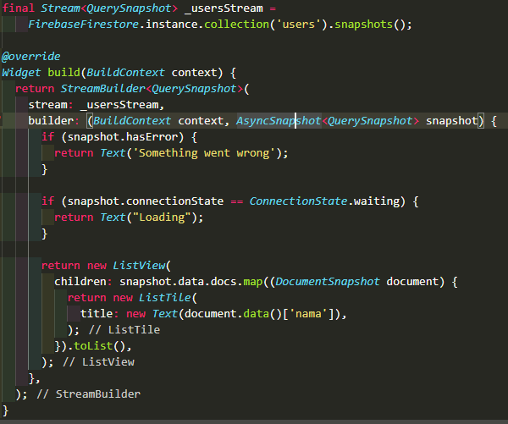
Read Data Firestore
Setelah dikembalikan, Anda bisa memperbaharui melalui metode listen (). Contoh di bawah ini menggunakan StreamBuilder yang membantu mengelola status aliran dan pembuangan aliran secara otomatis saat tidak lagi digunakan dalam aplikasi Anda:
Notes:
Save Time....:
The Platform will house/aggregate thousands of DIRECT SUPPLIERS. Buyer members are now abled to easily Pick whats best suitable for them.
Discover...:
Suppliers need to be a registered and verified members. There will be features such as ratings and certifications to boost further.
Grow Business:
Members akan di-empowered dengan sebuah tool digital yang yang tadinya menyerang industri, malah justru membuat mereka bisa menjadi lebih kompetitif di era digital.

Slide 7
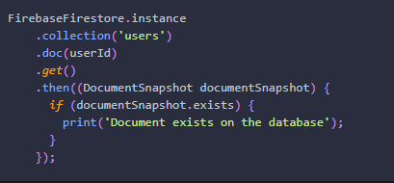
Document Snaphot
DocumentSnapshot dikembalikan dari kueri, atau dengan mengakses dokumen secara langsung. Meskipun tidak ada dokumen dalam database, snapshot akan selalu dikembalikan.
Untuk menentukan apakah dokumen tersebut ada, gunakan properti existing:
Notes:
Save Time....:
The Platform will house/aggregate thousands of DIRECT SUPPLIERS. Buyer members are now abled to easily Pick whats best suitable for them.
Discover...:
Suppliers need to be a registered and verified members. There will be features such as ratings and certifications to boost further.
Grow Business:
Members akan di-empowered dengan sebuah tool digital yang yang tadinya menyerang industri, malah justru membuat mereka bisa menjadi lebih kompetitif di era digital.

Slide 8
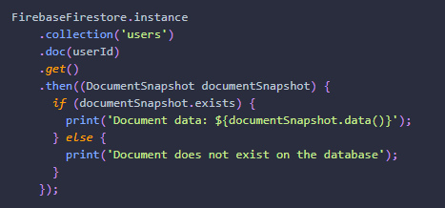
Document Snapshot
Jika dokumen tersebut ada, Anda dapat membaca datanya dengan memanggil metode data, yang mengembalikan Map <String, dynamic>, atau null jika tidak ada:
Notes:
Save Time....:
The Platform will house/aggregate thousands of DIRECT SUPPLIERS. Buyer members are now abled to easily Pick whats best suitable for them.
Discover...:
Suppliers need to be a registered and verified members. There will be features such as ratings and certifications to boost further.
Grow Business:
Members akan di-empowered dengan sebuah tool digital yang yang tadinya menyerang industri, malah justru membuat mereka bisa menjadi lebih kompetitif di era digital.

Slide 9
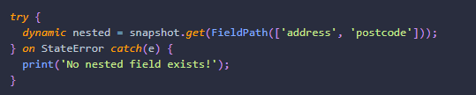
Document Snapshot
DocumentSnapshot juga menyediakan kemampuan untuk mengakses data yang sangat bertingkat tanpa mengulang Peta yang dikembalikan secara manual melalui metode get. Metode ini menerima jalur yang dipisahkan titik atau instance FieldPath. Jika tidak ada data di jalur bersarang, sebuah StateError:
Notes:
Save Time....:
The Platform will house/aggregate thousands of DIRECT SUPPLIERS. Buyer members are now abled to easily Pick whats best suitable for them.
Discover...:
Suppliers need to be a registered and verified members. There will be features such as ratings and certifications to boost further.
Grow Business:
Members akan di-empowered dengan sebuah tool digital yang yang tadinya menyerang industri, malah justru membuat mereka bisa menjadi lebih kompetitif di era digital.

Slide 10
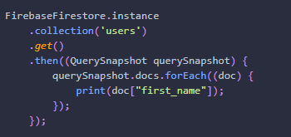
Query Snapshot
QuerySnapshot dikembalikan dari kueri koleksi, dan memungkinkan Anda untuk memeriksa koleksi, seperti berapa banyak dokumen yang ada di dalamnya, memberikan akses ke dokumen dalam koleksi, melihat perubahan apa pun sejak kueri terakhir, dan banyak lagi.
Untuk mengakses dokumen dalam QuerySnapshot, panggil properti docs, yang mengembalikan Daftar yang berisi kelas DocumentSnapshot.
Notes:
Save Time....:
The Platform will house/aggregate thousands of DIRECT SUPPLIERS. Buyer members are now abled to easily Pick whats best suitable for them.
Discover...:
Suppliers need to be a registered and verified members. There will be features such as ratings and certifications to boost further.
Grow Business:
Members akan di-empowered dengan sebuah tool digital yang yang tadinya menyerang industri, malah justru membuat mereka bisa menjadi lebih kompetitif di era digital.

Slide 11
Macam-macam Query
Cloud Firestore menawarkan kemampuan lanjutan untuk membuat kueri koleksi. Kueri berfungsi dengan membaca satu kali atau berlangganan perubahan.
Berikut ini adalah beberapa macam query :
Filtering
Limiting
Ordering
Notes:
Save Time....:
The Platform will house/aggregate thousands of DIRECT SUPPLIERS. Buyer members are now abled to easily Pick whats best suitable for them.
Discover...:
Suppliers need to be a registered and verified members. There will be features such as ratings and certifications to boost further.
Grow Business:
Members akan di-empowered dengan sebuah tool digital yang yang tadinya menyerang industri, malah justru membuat mereka bisa menjadi lebih kompetitif di era digital.

Slide 12
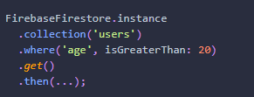
Macam-macam Query
Filtering
Untuk memfilter dokumen dalam koleksi, metode where dapat dirangkai ke referensi koleksi. Pemfilteran mendukung pemeriksaan kesetaraan dan kueri "dalam". Misalnya, untuk pengguna filter yang usianya lebih dari 20 tahun:
Notes:
Save Time....:
The Platform will house/aggregate thousands of DIRECT SUPPLIERS. Buyer members are now abled to easily Pick whats best suitable for them.
Discover...:
Suppliers need to be a registered and verified members. There will be features such as ratings and certifications to boost further.
Grow Business:
Members akan di-empowered dengan sebuah tool digital yang yang tadinya menyerang industri, malah justru membuat mereka bisa menjadi lebih kompetitif di era digital.

Slide 13
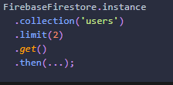
Macam-macam Query
Limiting
Untuk membatasi jumlah dokumen yang dikembalikan dari kueri, gunakan metode batas pada referensi koleksi:
Notes:
Save Time....:
The Platform will house/aggregate thousands of DIRECT SUPPLIERS. Buyer members are now abled to easily Pick whats best suitable for them.
Discover...:
Suppliers need to be a registered and verified members. There will be features such as ratings and certifications to boost further.
Grow Business:
Members akan di-empowered dengan sebuah tool digital yang yang tadinya menyerang industri, malah justru membuat mereka bisa menjadi lebih kompetitif di era digital.

Slide 14
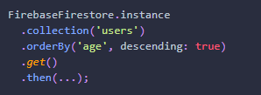
Macam-macam Query
Ordering
Untuk memesan dokumen dengan nilai tertentu, gunakan metode orderBy:
Notes:
Save Time....:
The Platform will house/aggregate thousands of DIRECT SUPPLIERS. Buyer members are now abled to easily Pick whats best suitable for them.
Discover...:
Suppliers need to be a registered and verified members. There will be features such as ratings and certifications to boost further.
Grow Business:
Members akan di-empowered dengan sebuah tool digital yang yang tadinya menyerang industri, malah justru membuat mereka bisa menjadi lebih kompetitif di era digital.

Slide 15
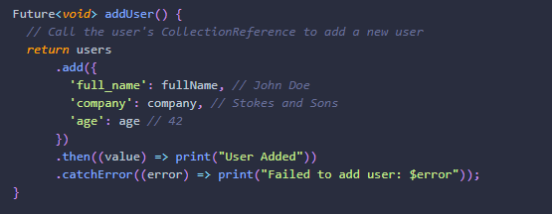
Add
Untuk menambahkan dokumen baru ke koleksi, gunakan metode add pada CollectionReference:
Notes:
Save Time....:
The Platform will house/aggregate thousands of DIRECT SUPPLIERS. Buyer members are now abled to easily Pick whats best suitable for them.
Discover...:
Suppliers need to be a registered and verified members. There will be features such as ratings and certifications to boost further.
Grow Business:
Members akan di-empowered dengan sebuah tool digital yang yang tadinya menyerang industri, malah justru membuat mereka bisa menjadi lebih kompetitif di era digital.

Slide 16
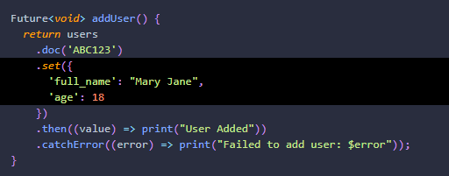
Add
Metode add menambahkan dokumen baru ke koleksi Anda dengan ID unik yang dibuat secara otomatis. Jika Anda ingin menentukan ID Anda sendiri, panggil metode set pada DocumentReference:
Notes:
Save Time....:
The Platform will house/aggregate thousands of DIRECT SUPPLIERS. Buyer members are now abled to easily Pick whats best suitable for them.
Discover...:
Suppliers need to be a registered and verified members. There will be features such as ratings and certifications to boost further.
Grow Business:
Members akan di-empowered dengan sebuah tool digital yang yang tadinya menyerang industri, malah justru membuat mereka bisa menjadi lebih kompetitif di era digital.

Slide 17
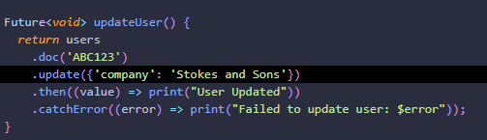
Update
Terkadang Anda mungkin ingin memperbarui dokumen, daripada mengganti semua data. Metode set di atas menggantikan semua data yang ada pada DocumentReference tertentu. Jika Anda ingin memperbarui dokumen, gunakan metode pembaruan:
Notes:
Save Time....:
The Platform will house/aggregate thousands of DIRECT SUPPLIERS. Buyer members are now abled to easily Pick whats best suitable for them.
Discover...:
Suppliers need to be a registered and verified members. There will be features such as ratings and certifications to boost further.
Grow Business:
Members akan di-empowered dengan sebuah tool digital yang yang tadinya menyerang industri, malah justru membuat mereka bisa menjadi lebih kompetitif di era digital.

Slide 18
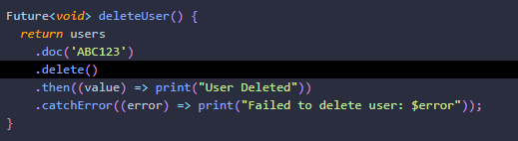
Delete
Untuk menghapus dokumen dengan Cloud Firestore, Anda dapat menggunakan metode delete di DocumentReference:
Notes:
Save Time....:
The Platform will house/aggregate thousands of DIRECT SUPPLIERS. Buyer members are now abled to easily Pick whats best suitable for them.
Discover...:
Suppliers need to be a registered and verified members. There will be features such as ratings and certifications to boost further.
Grow Business:
Members akan di-empowered dengan sebuah tool digital yang yang tadinya menyerang industri, malah justru membuat mereka bisa menjadi lebih kompetitif di era digital.

Slide 19
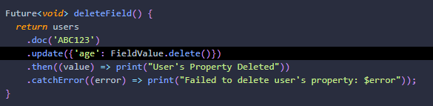
Delete
Jika Anda perlu menghapus properti tertentu dari dalam dokumen daripada dokumen itu sendiri, Anda dapat menggunakan metode delete dengan kelas FieldValue:
Notes:
Save Time....:
The Platform will house/aggregate thousands of DIRECT SUPPLIERS. Buyer members are now abled to easily Pick whats best suitable for them.
Discover...:
Suppliers need to be a registered and verified members. There will be features such as ratings and certifications to boost further.
Grow Business:
Members akan di-empowered dengan sebuah tool digital yang yang tadinya menyerang industri, malah justru membuat mereka bisa menjadi lebih kompetitif di era digital.

Slide 20
DISCLAIMER
The information in this presentation is provided to you by PT. AXAR Technology Raya, solely for informational purposes and does not constitute an offer to buy, sell or issue, or a solicitation of an offer to sell, buy or acquire any securities of the Company in any jurisdiction or an inducement to enter into investment activity, nor may it or any part of it form the basis of or be relied on in connection with any contract or commitment whatsoever. No representations or warranties, express or implied, are made by the Company, any underwriters, any of their respective affiliates, directors, officers, employees, advisors or representatives with respect to, and no reliance should be placed, on the accuracy, fairness or completeness of the information presented or contained in this presentation. By viewing this presentation, you agree that none of the Company, any underwriters, nor any of their respective affiliates, directors, officers, employees, advisors or representatives accepts any responsibility or liability whatsoever for any loss howsoever arising from any information presented or contained in or derived from or omitted from this presentation. The information presented or contained in this presentation was obtained from various sources, including certain third parties, and has not been independently verified, and its accuracy is not guaranteed.
This presentation does not contain all relevant information relating to the Company or its securities, particularly with respect to the risks and special considerations involved with an investment in the securities of the Company. These materials are not an offer of securities for sale. Any public offering will be made by means of a prospectus that may be obtained from the issuer and that will contain detailed information about the company and management, as well as financial statements. This presentation speaks as of its date and the information presented or contained in this presentation is subject to change without notice or update.
This presentation contains statements that constitute forward-looking statements. These statements include descriptions regarding the intent, belief or current expectations of the Company or its officers about the future. These statements can be recognized by the use of words such as “expects,” “plans,” “will,” “estimates,” “projects,” “intends,” or words of similar meaning. Such forward-looking statements are not guarantees of future performance and involve risks and uncertainties, and actual results may differ from those in the forward-looking statements as a result of various factors and assumptions, many of which are beyond the Company’s control. The Company or any of its affiliates, advisors, representatives or underwriters has no obligation and does not undertake to revise forward-looking statements to reflect future events or circumstances.
THE INFORMATION CONTAINED IN THIS DOCUMENT IS HIGHLY CONFIDENTIAL AND MAY NOT BE FORWARDED, PUBLISHED OR DISTRIBUTED, DIRECTLY OR INDIRECTLY, TO ANY OTHER PERSON (WHETHER WITHIN OR OUTSIDE YOUR ORGANIZATION/FIRM) FOR ANY PURPOSE AND MAY NOT BE REPRODUCED IN ANY MANNER WHATSOEVER. ANY FORWARDING, PUBLICATION, DISTRIBUTION OR REPRODUCTION OF THIS DOCUMENT IN WHOLE OR IN PART IS UNAUTHORIZED.
THANK YOU

